Slide 1

LiDAR-based Canopy Cover prediction
May 24th Update
Alejandro Donaire Èric Sánchez Pau Ventura

Slide 2
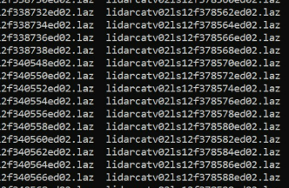
Full Catalonia LiDAR data inside HPC cluster
8434 .laz files
213GB
Took ~5h to upload, ~30m to unzip
Ready to be used by our functions

Slide 3
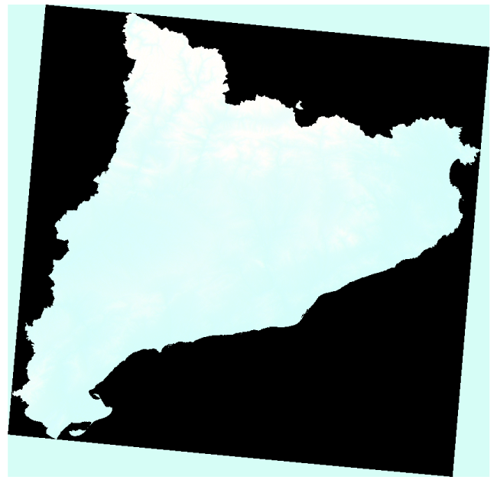
Successfully read Burgan LCP (not implemented yet)
Elevation
Slope
Aspect

Slide 4
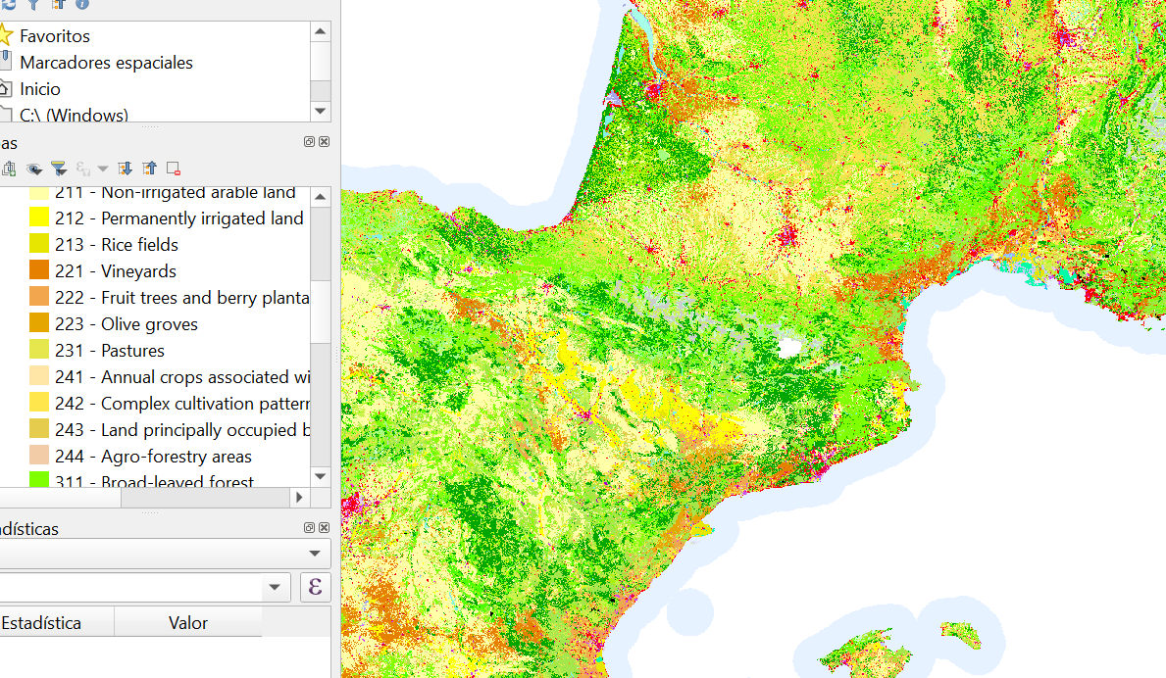
LandUse - GISAT
100m resolution
Hardly no improvement ( 0.8140 → 0.8144 )

Slide 5
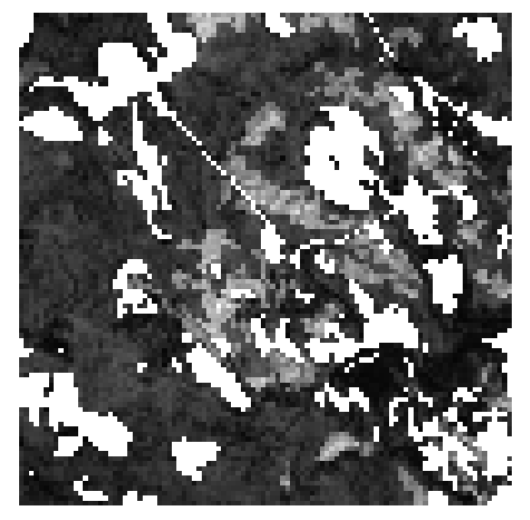
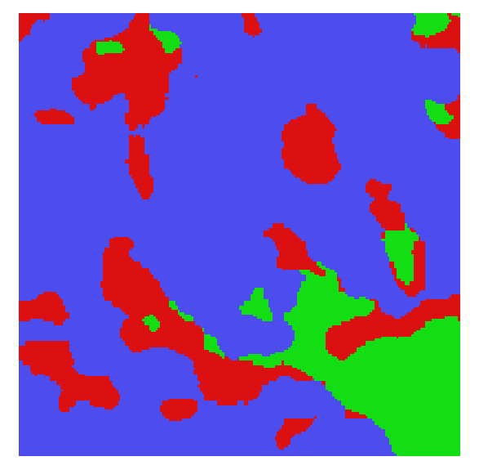
Groundtruth - LandUse comparison
Red: Rangeland
Blue: Trees
Green: Built area

Slide 6
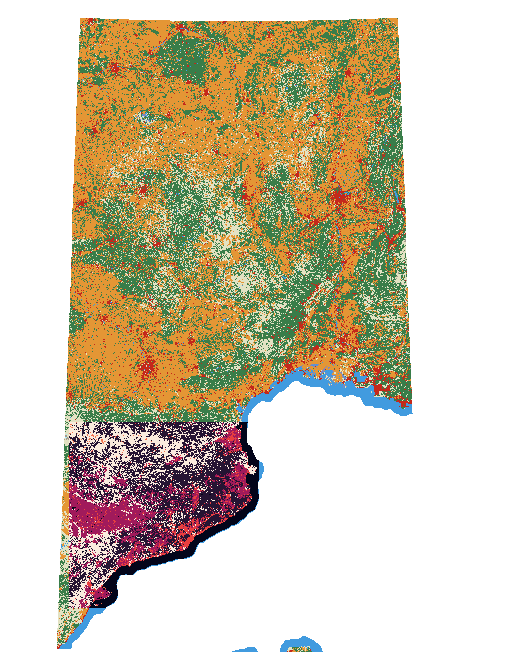
LandUse - Eris
Very high resolution (10x10m)
Catalonia only → 700M rows
Worldwide
Potentially very helpful
Updated each year

Slide 7
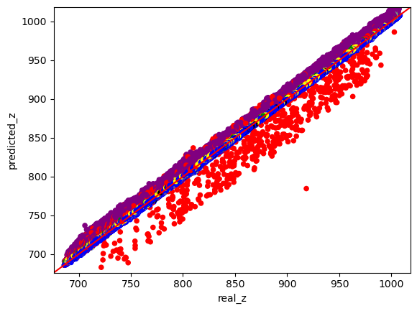
Heights analysis
Blue: Surface point simplification
Red: Low point (> 1m lower than neighborhood points)
Purple: High vegetation
Black: Points not classificated as ground but suspicious of belonging.

Slide 8

Visual summary…

Slide 9
Next week (or weeks…)
Implement Burgan LCP
Implement high resolution Eris LandUse
Prepare Python scripts for execution in cluster
Solve other technical issues and get ready to execution in cluster

